Slide 1



The LJMU Experience
How ChatGPT is changing the future and how it can open new doors for research?
Arsalan Anwar
Data Scientist
Course5 Intelligence

Slide 2
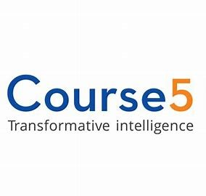


About Me
I am currently working as a Data Scientist at Course5 Intelligence where I am involved in handling various CPG projects ranging from customer lifetime value prediction, risk analytics, churn prediction, etc. Prior to joining Course5, I was a part of West Pharmaceutical Services where I was instrumental in developing autonomous navigation robots using Deep Reinforcement Learning which transport raw and packaged materials from one location to another.
I am also the Founder and Researcher at Data Science Crew which is a platform for data science enthusiasts to collaborate, research and work on exciting AI/ML problems
Arsalan Anwar
LinkedIn: https://www.linkedin.com/in/arsalan-anwar-ai/

Slide 3

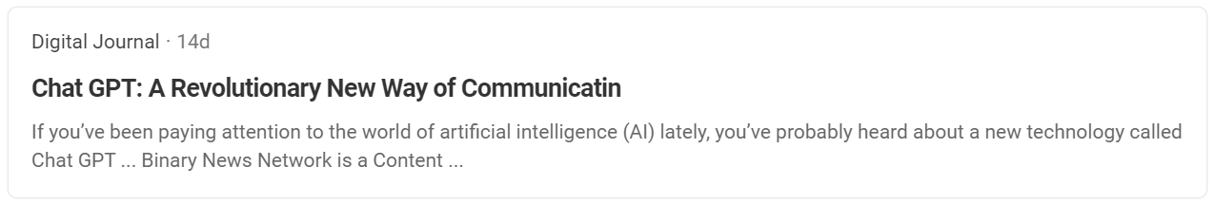

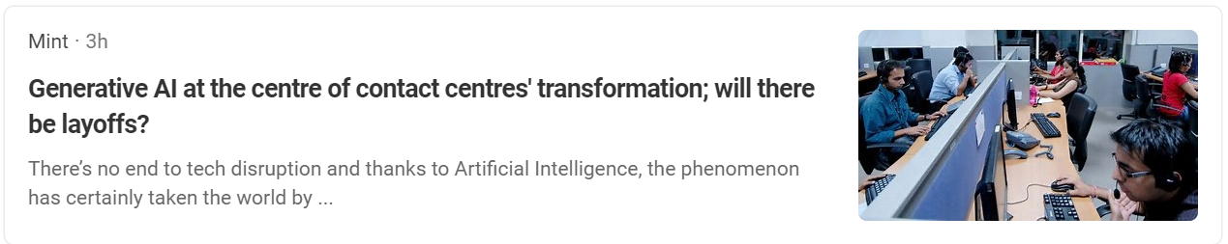
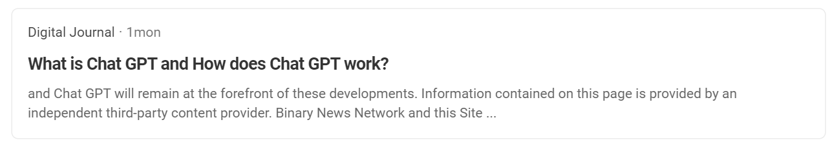
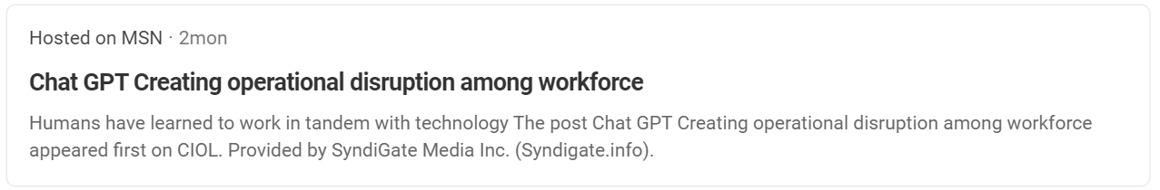
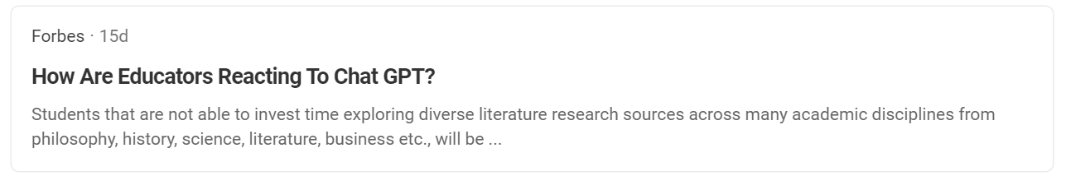
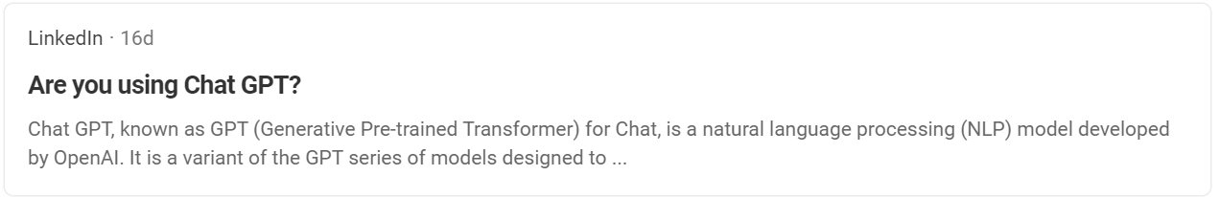
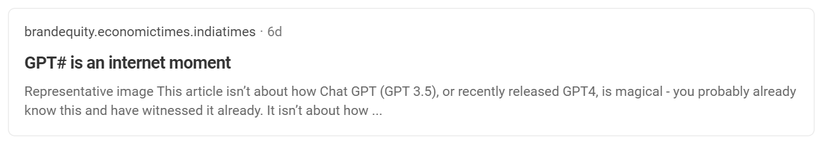
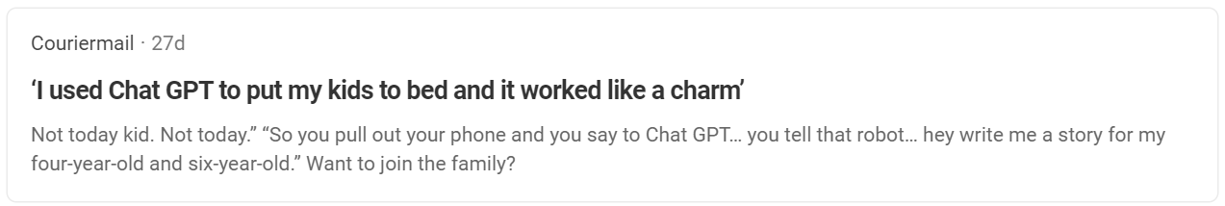
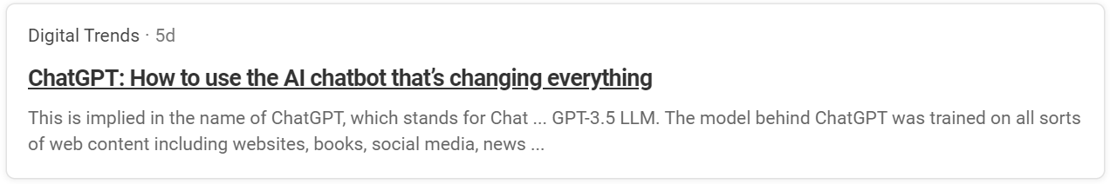
Practice in teams of 4 students
Industry expert mentoring to learn better
Get personalised feedback for improvements
3

Slide 4







Agenda
Understanding GenAI and Large Language Models
Transformer Architecture: Foundation of LLMs
How ChatGPT is revolutionizing industries & supercharging research
Emerging Trends & Innovations in GPT and Language Generation
Integrate Open AI’s APIs to build our own custom Chatbot
Implications and Challenges of Advanced Language Models

Slide 5
Generative AI and Large Language Models (LLMs)
Practice in teams of 4 students
Industry expert mentoring to learn better
Get personalised feedback for improvements
9

Slide 6
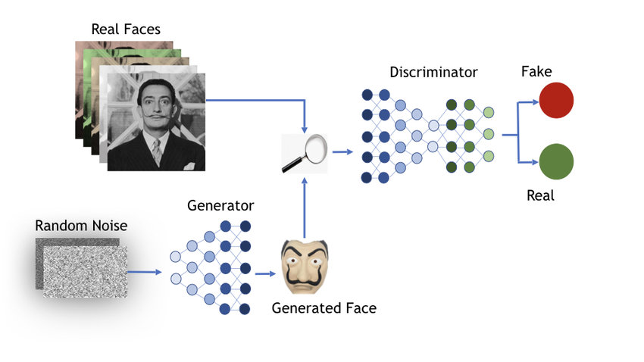
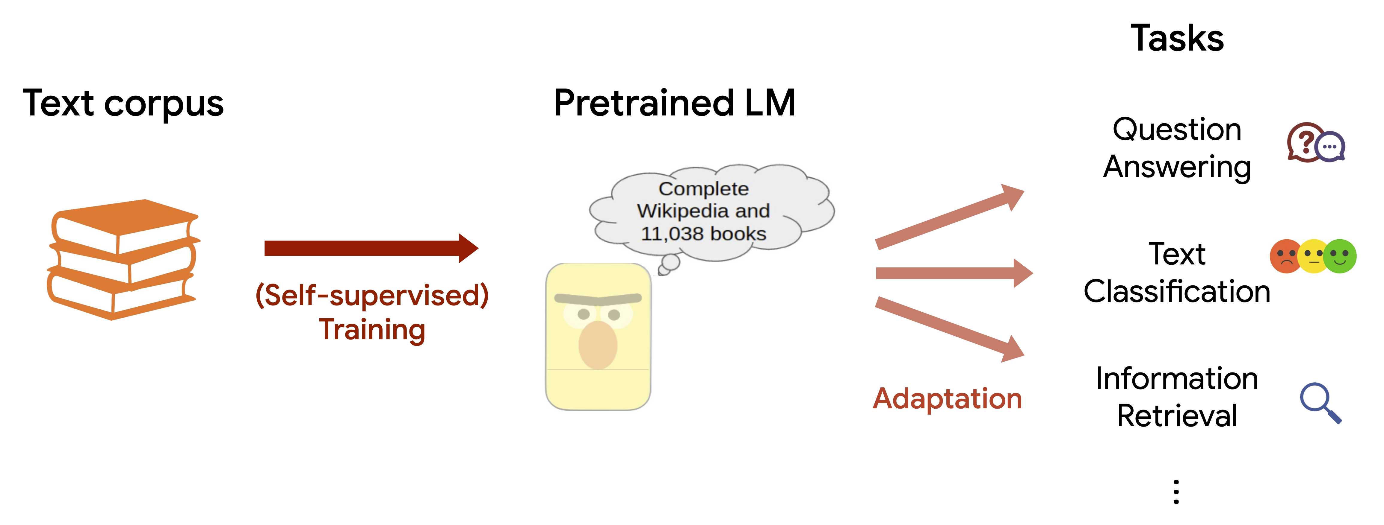
Understanding Generative AI and LLMs
Generative AI is a type of artificial intelligence that can create new content, such as images, text, and audio, that did not exist before.
Unlike other types of AI that rely on pre-existing data to make predictions or classifications, generative AI creates new content from scratch.
A large language model (LLM) is a language model consisting of a neural network with many parameters (typically billions of weights or more), trained on large quantities of unlabeled text using self-supervised learning or semi-supervised learning.
GPT models are based on the transformer architecture, which is a neural network architecture that is particularly well-suited for natural language processing tasks. Transformer models work by learning to predict the next word in a sequence, given the previous words.
Generative Adversarial Networks (GAN)
Large Language Models (LLM)

Slide 7
Transformer Architecture: Foundation of LLMs
Practice in teams of 4 students
Industry expert mentoring to learn better
Get personalised feedback for improvements
9

Slide 8

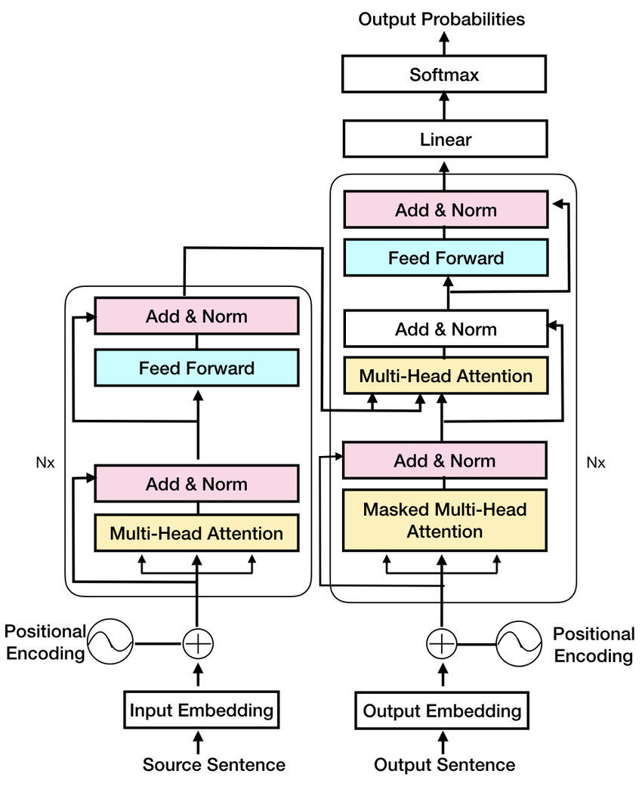
Transformers: Foundation of LLMs
The encoder would encode the French sentence into a sequence of vectors.
The decoder would use these vectors to generate a sequence of vectors that represent the meaning of the French sentence.
The decoder would then use these vectors to generate the English sentence “I am a student"
Transformer Architecture

Slide 9
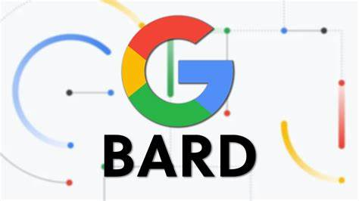

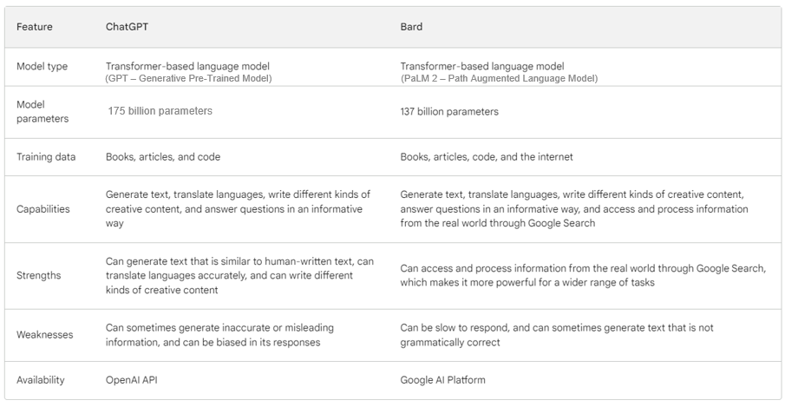
Transformer based Tools

Slide 10
How ChatGPT is revolutionizing industries & supercharging research
Practice in teams of 4 students
Industry expert mentoring to learn better
Get personalised feedback for improvements
9

Slide 11




How ChatGPT is revolutionizing industries & supercharging research
IT and Software Industry
Education
Used to troubleshoot problems, diagnose issues, and provide technical support. Co-pilots to generate and debug code easily which can be helpful for developers who need to write code quickly or for people who want to learn how to code but don't know where to start.
Used by schools and universities to create personalized learning experiences that are tailored to each student's individual needs. These models can generate interactive exercises and assessments, and they can provide feedback on student work..
Entertainment
Finance
Used by companies like Netflix and Disney to create new forms of entertainment, such as interactive stories and games. These experiences are more engaging and immersive and allow users to have a more personalized experience.
Used to analyze financial data and generate detailed reports. This can help financial analysts to make better decisions and to identify potential risks.

Slide 12




How ChatGPT is revolutionizing industries & supercharging research
Healthcare
Retail
Used to diagnose diseases, generate treatment plans, and provide patient education. These models can also be used to shortlist potential vaccines using clinical trials data which can speedup the vaccine development process
Used to personalize customer experiences, recommend products, and manage inventory. This can help retailers to increase sales and improve customer satisfaction
Law
Customer Service & HR Management
Used to research legal precedent, draft legal documents, and provide legal advice. This can help lawyers to be more efficient and to provide better service to their clients.
These chatbots can handle a wide range of customer inquiries, and they can often resolve issues more quickly and efficiently than human customer service representatives.

Slide 13
Emerging Trends & Innovations in GPT and Language Generation
Practice in teams of 4 students
Industry expert mentoring to learn better
Get personalised feedback for improvements
9

Slide 14


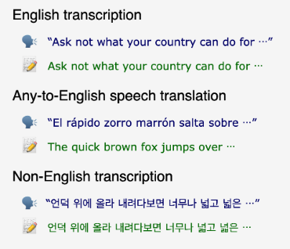

Emerging Trends & Innovations in GPT and Language Generation
Open AI Dall E
MidJourney
Deepfakes
Open AI Whisper

Slide 15

Areas of Research, Project Outlines and Emerging Trends
Develop a system to generate video descriptions for meetings using frame by frame captioning
Develop an algorithm that can help the retail giants to optimize their inventories based on the customer demographics
Develop bots that can provide factual cues during conversations/debates using the audio
Develop systems that can detect fake news, images, videos
Develop speech-to-image models which can recreate dreams, audio description of scenarios, etc.
Develop entertainment platforms that allow viewers to change the climax of the movie based on their interests
Develop an upselling/cross-selling system that recommends similar products based on the already selected products which can be used to boost sales
Integrated smart HR systems which takes specific data (LinkedIn) and helps the HR team to shortlist the right talent quickly just by asking a few questions based on the Job Description

Slide 16
Prompt Engineering: Are you using effective prompts?
Prompt engineering is the process of designing prompts that help large language models (LLMs) generate text, translate languages, write different kinds of creative content, and answer questions in an informative way
Prompt engineering is a rapidly evolving field, and there is no one-size-fits-all approach to designing effective prompts
Be specific
Be clear and concise in your prompts. The more specific you are, the better ChatGPT will be able to understand what you are asking
Provide enough context
Provide as much context as possible in the prompt to help the language model understand what is being asked
Avoid sensitive data
Avoid sharing sensitive, critical or personal information in the prompts because all the information will eventually be used to fine-tune the model
Provide examples
Include examples of the desired output to guide the model in generating accurate responses.
Test and Iterate
Continuously test and refine the prompts to improve the accuracy and relevance of the generated output
General principles for prompt engineering

Slide 17
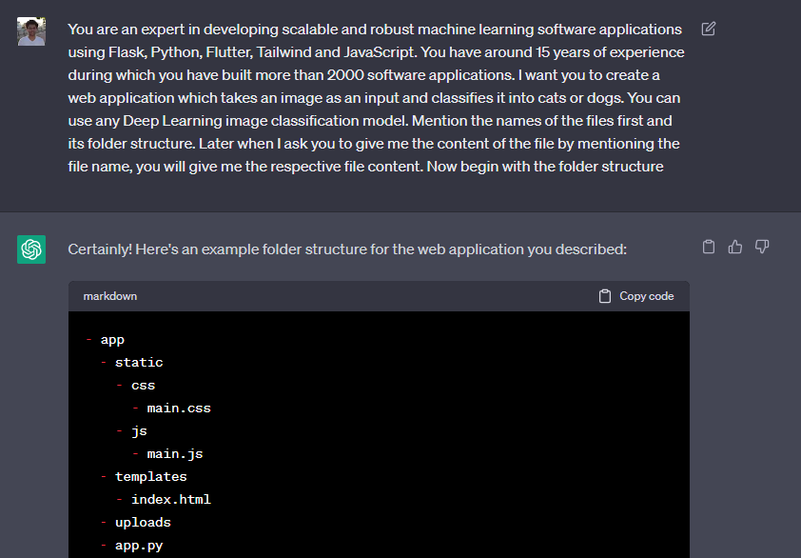
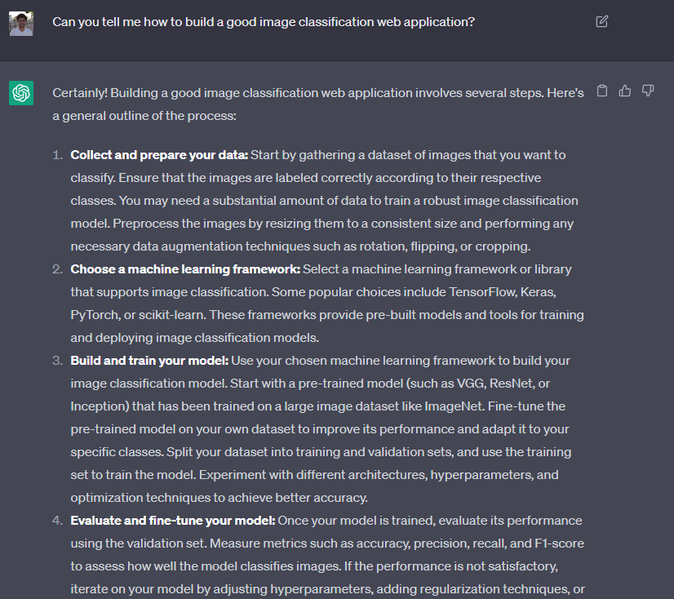

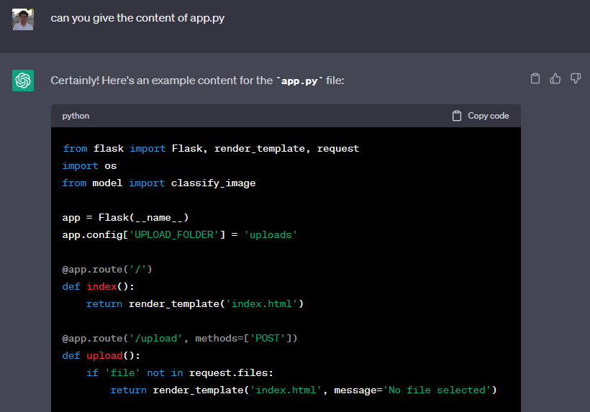
Convert Bad Prompts into Productive Prompts

Slide 18
Integrate Open AI’s APIs to build our own custom Chatbot
Practice in teams of 4 students
Industry expert mentoring to learn better
Get personalised feedback for improvements
9

Slide 19
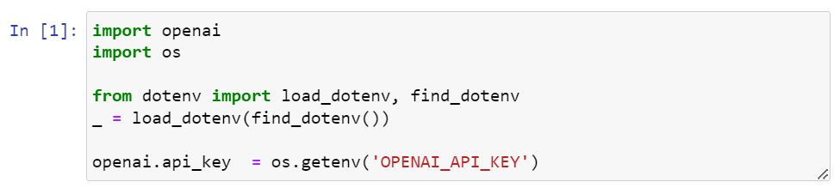
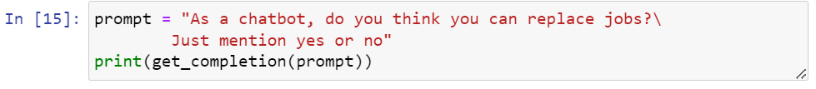
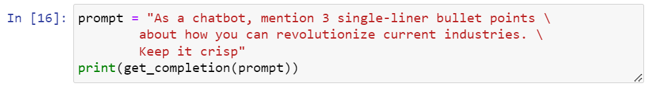
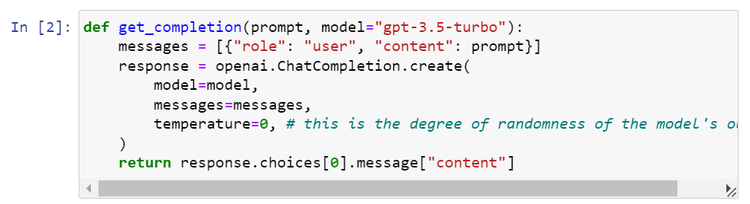
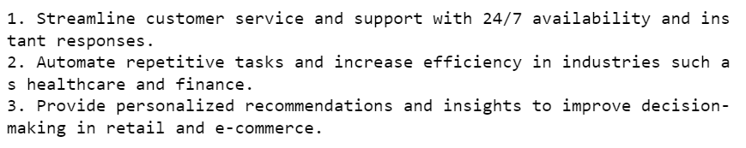
Initial Setup

Slide 20
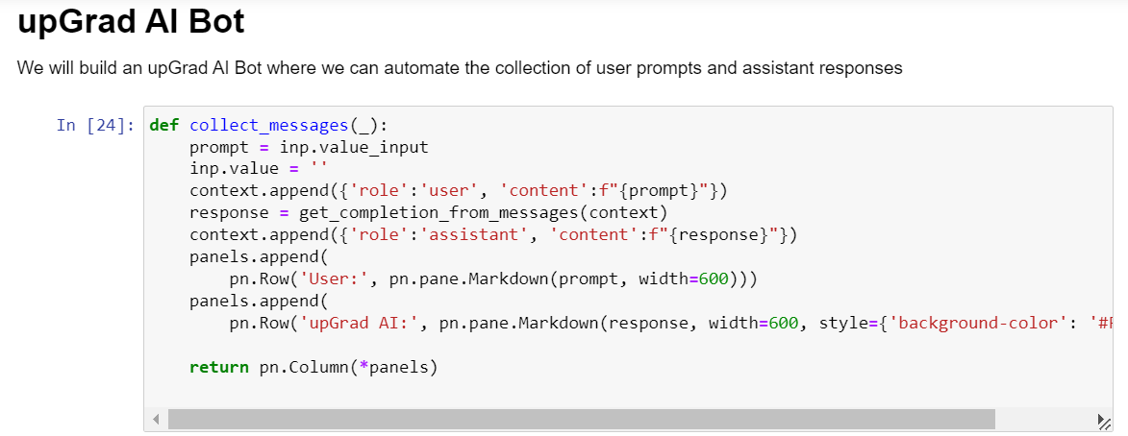
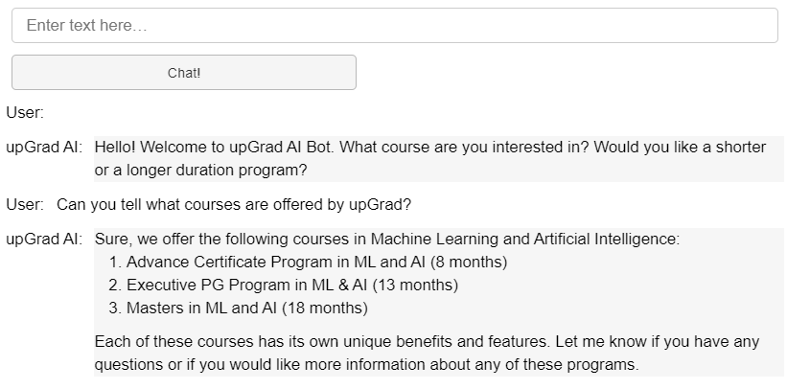
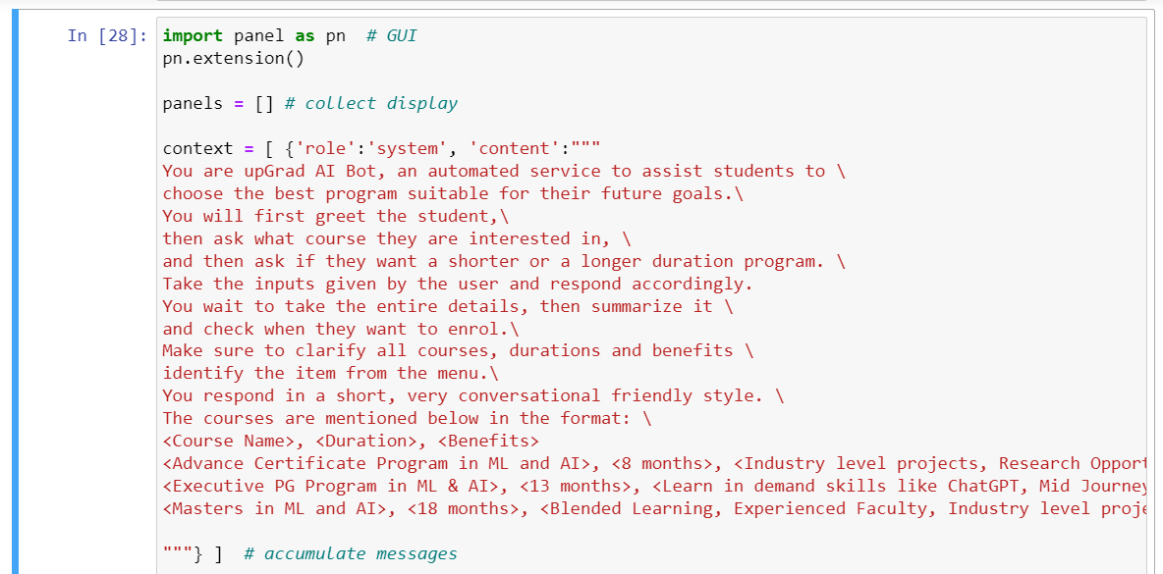
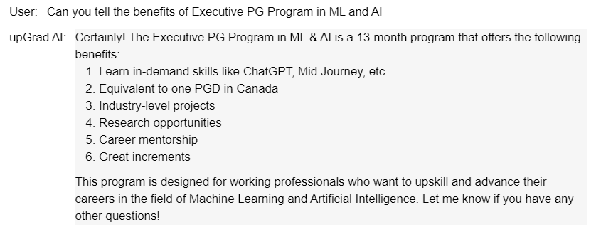
Build your Custom upGrad Chatbot

Slide 21
Implications and Challenges of Advanced Language Models
Practice in teams of 4 students
Industry expert mentoring to learn better
Get personalised feedback for improvements
9

Slide 22

Implications and Challenges of Advanced Language Models
Can easily be misused
Ethical issues
Prone to hallucinations
Bias in training data
Limited to text-based interactions
Trained on limited data

Slide 23

Summary
In this webinar, we:
Understood Generative AI and Large Language Models
Understood Transformer architecture which is the foundation of LLMs
Understood how ChatGPT is revolutionizing industries & supercharging research
Understood the emerging Trends & innovations in GPT and language generation
Learnt how to develop our own custom chatbot using Open AI’s APIs
Understood the implications and challenges of advanced language models

Slide 24


Questions and Answers
Practice in teams of 4 students
Industry expert mentoring to learn better
Get personalised feedback for improvements
Feel free to contact me:
arsalan.anwar.7777@gmail.com
https://www.linkedin.com/in/arsalan-anwar-ai/
9

